Slide 1
Get going with GitHub actions
Björn Sundling
Notes:
Code C:\GitHub\bjompen\PSConf2023-GHA
https://github.com/bjompen/PSConfEU2023-GHA1
https://github.com/bjompen/PSConfEU2023-GHA2
https://github.com/bjompen/PSConfEU2023-GHA2-Runner
https://github.com/bjompen/PSConfEU2023-GHA3
https://github.com/bjompen/PSConfEU2023-GHA-Docker
https://github.com/bjompen/PSConfEU-GHA-Work

Slide 2

Many thanks to our sponsors:

Slide 3

Björn Sundling
Bio means cinema in Swedish. That’s a thing you know now.
Azure DevOps consultant @ Advania Sweden
Writer of texts @ bjompen.com
Releaser of codes @ GitHub.com/bjompen
Walker of dogs @ home with Karma

Slide 4
Agenda
What is GitHub actions?
(for real.. This is not as clear as you’d think)
My first action
Decorations
Publishing actions
Container actions
PSDevOps – the lazy way to actions

Slide 5
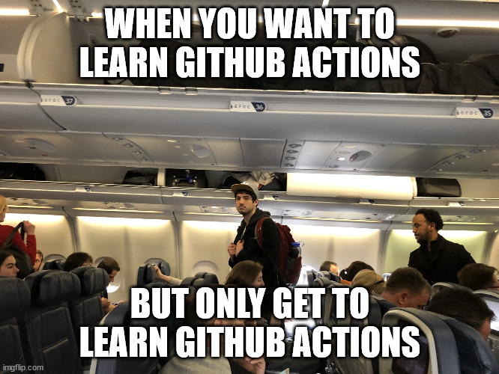
What is GitHub actions?
What is GitHub actions
GitHub Actions – The Platform
Workflows
RUNNER
Actions
Event
Jobs
Actions
Notes:
Actions -> workflows -> parts of workflows -> Actions again
Because naming the same thing twice.
Finding them in gallery - https://github.com/marketplace?type=actions
Difference from workflows – Terminology. A Workflow can contains actions. Action keyword = “Uses”
Three types of actions:
Docker. Containers. Runs only on Linux, requires docker to be installed on host machine.
Javascript – Runs directly on machine using existing binaries. Faster, but depends on machine configuration.
Composite – The odd one out. Combines one or more “run” steps in to one reusable action.
Focus today is *CLICK* Composite.
If you want to learn Github Actions *CLICK*

Slide 6
Demos
My first action!
Notes:
https://github.com/bjompen/PSConfEU2023-GHA1
In a folder because demo. Later will move to root
My function – outputs fruits.
If parameter –Icons, outputs images of fruits.
RunMyAction.yaml – to testrun my created action
- On: workflow_dispatch – when I click run
- Uses: every uses is an action
action.yaml
Name and description required
Runs instead of Jobs
Using instead of runs-on
Composite. Tells actions which type of action
Steps just like in workflows.

Slide 7
Demos
Improved and shared actions!
Notes:
https://github.com/bjompen/PSConfEU2023-GHA2
https://github.com/bjompen/PSConfEU2023-GHA2-Runner
Create repo 2
Action.yaml in root
Public repo
Calling from workflow in external repo
Adding log output – Workflow commands
Text to log using “::group::”, “::notice::”, and “::error::”
Notice shows up in summary
Takes parameters inside colon - ::notice file={name},line={line},endLine={endLine},title={title}::{message}
Others exist, such as ::debug::, ::warning::
https://docs.github.com/en/actions/using-workflows/workflow-commands-for-github-actions
Adding input – set icons on or off
Inputs is string – some magic required for bool!
https://docs.github.com/en/actions/creating-actions/metadata-syntax-for-github-actions#inputs
Output to calling workflow – Output icons or text as a string to calling workflow
Variables or files to workflow? Depends on when you need the output!
https://docs.github.com/en/actions/creating-actions/metadata-syntax-for-github-actions#outputs-for-composite-actions

Slide 8
Demos
Published actions!
Notes:
Adding metadata
Description: - Is required, but should be good before publish
Branding: - Is what we should talk about
branding:
Color: white, yellow, blue, green, orange, red, purple, or gray-dark.
Icon: https://feathericons.com/
https://docs.github.com/en/actions/creating-actions/metadata-syntax-for-github-actions#branding
Add to marketplace – Uses metadata yaml file
Globally unique name
Must be public repo
Yaml file must be in root
One action per repo
Create release
Check “publish to marketplace”!!!

Slide 9
Demos
Container Actions!
Notes:
Needs a dockerfile
Runs PowerShell
PowerShell script does everything.
Uses $args – because that’s how I figured out it works
Sets output in script, just as in composite action

Slide 10
Demos
Shoutout:
James Brundage,
@StartAutomating
PSDevOps:
The lazy way to Actions!
https://github.com/StartAutomating/PSDevOps/
Notes:
Import-Module C:\GitHub\bjompen\PSConf2023-GHA\PSConfEU2023-GHA1\BasicFunction\
Import-BuildStep -ModuleName BasicFunction
New-GitHubAction -Name ‘FruitAPI' -Description 'description' -Action Invoke-FruitAPI -OutputPath C:\Temp\myAction.yaml -Icon Warning -Color red
Get-Content C:\Temp\myAction.yaml
https://github.com/StartAutomating/PSDevOps/

Slide 11
Q&A
Please, no hard questions… 😉

